Slide 1

Meraki Car Plate Recognition and Webex Notification for Pickup Order
GVE Devnet
Global Sales Segment : Global Enterprise
Industries : Retail
LoB : Operations Automation
Architectural Plays : Enterprise
Sales Plays : Transform Customer Experience
Muhammad Akbar, Hung Le and Swati Singh; Mentor: Alvin Lau
FY21 CSAP ASEs
May 2021

Slide 2

Retail
Operations Automation
Notes:
Mid market retail workshop

Slide 3



Meraki Car Plate Recognition and Webex Notification for Pickup Order
Business Needs/Challenges
Need: The customer requires an automated way to inform their employees when their customers arrive at the pickup stop for the order
Challenge: Due to large number of customers arriving spontaneously it becomes challenging for employees to manually filter out the right order quickly
Solution
Created an automated script that captures the Meraki camera snapshot when the vehicle arrives, it then uses a machine learning algortihm to identify the car plate number and match it with the right order. If there is a match, it notifies all the employees with a ChatBot notification in Webex.
Business Outcomes
Hassel free processing of all the incoming orders
Move from manual processing to matching the order digitally

Slide 4

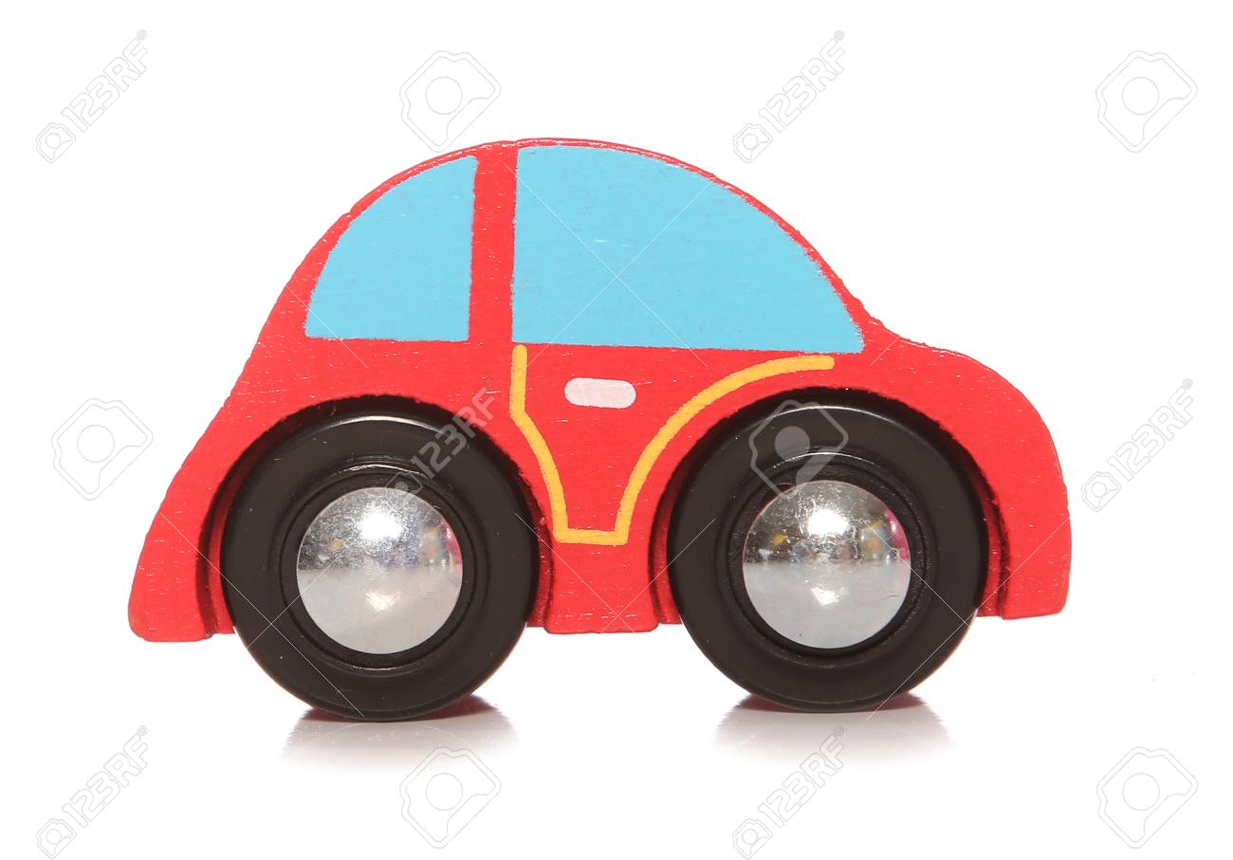

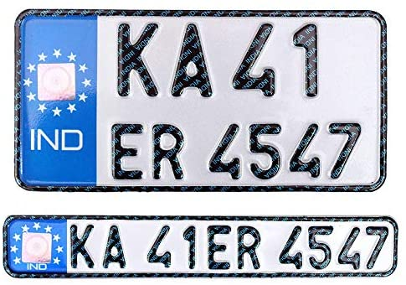

Meraki Car Plate Recognition and Webex Notification for Pickup Order
Automated ChatBot notification for the order pickup
Vehicles are detected on camera
Machine Learning is used to detect the car plate number
Staff will be notified when there is a match with an order

Slide 5
Meraki Car Plate Recognition and Webex Notification for Pickup Order
Customer / Opportunity
Meraki MV Opportunity
What is the story? What was the business challenge?
The customer would like to save shoppers’ time by processing their orders on arrivals. Having to manage online and in-store orders during peak time is producing operational challenges. Staff cannot efficiently serve customers.
What the PoV accomplished?
The POV creates a script to capture the snapshot of the vehicle arriving at the pickup store. By getting the car plate, orders can be identified and messages are sent to all the employees in a dedicated Webex room about their arrival.
What are the benefits to the customer?
The customer has an effective way to process order quickly hence improves client satisfaction by reducing wait time

Slide 6


High Level Design PoV
1. The Snapshot is captured via Meraki API upon Motion detection
2. Google OCR is used to detect the car plate number
3. If there’s a match with the order database, a Webex ChatBot notification is sent to all the employees
https://wwwin-github.cisco.com/gve/gve_devnet_meraki_car_plate_recognition
Notes:
Walk through how (one level deeper) this works.

Slide 7
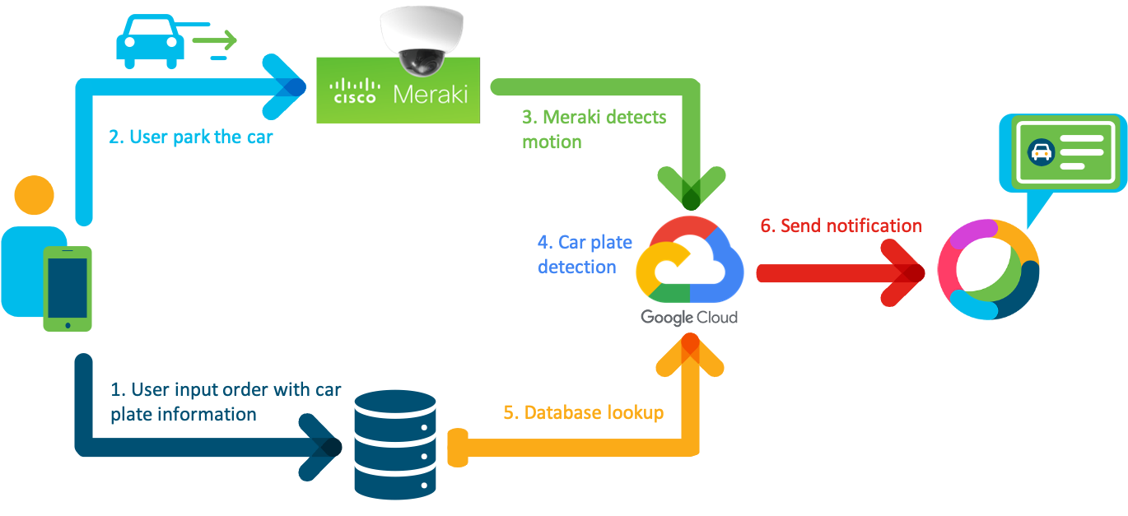
High Level Design PoV
https://wwwin-github.cisco.com/gve/gve_devnet_meraki_car_plate_recognition
Notes:
Walk through how (one level deeper) this works.

Slide 8
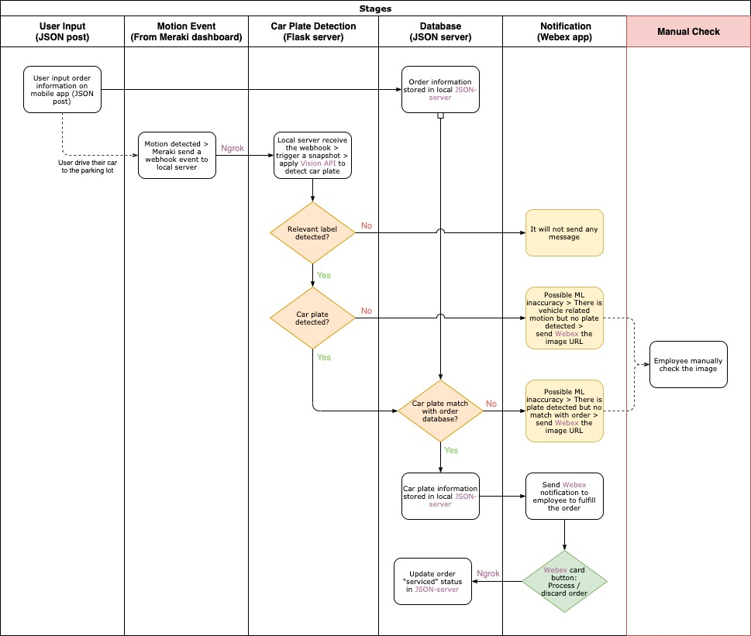
Low Level Design
Notes:
Walk through how (one level deeper) this works.

Slide 9
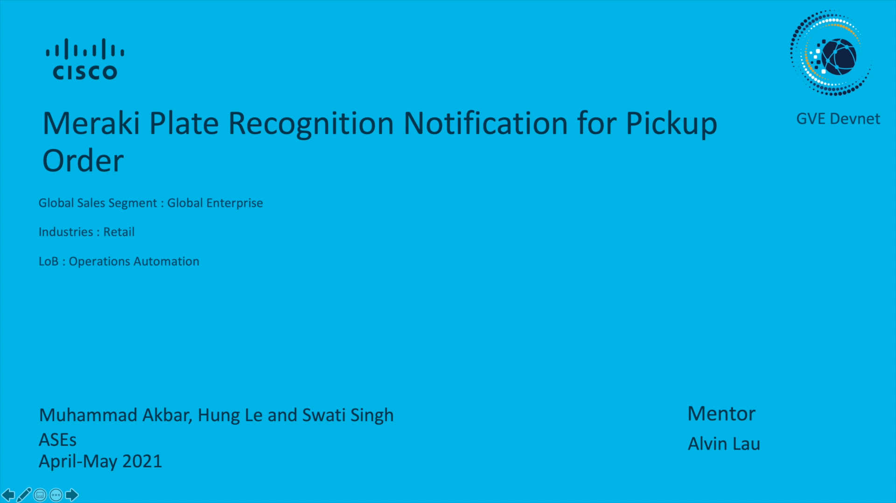
Demo
Add link to the video url. [Portal Link]

Slide 10
Tools and Products Used
Meraki MV
Webex Teams
Python 3.8
Google Vision OCR API

Slide 11
Check out the GVE Devnet team @
https://gve-devnet.cisco.com/
Open a GVE case @
https://cep.cloudapps.cisco.com/case
Notes:
Missing : Page for Achitectural plays : Enter
Sales pla – fIRST ONE : No technical consideration , very high level
Next one : After you dfeliver a prototype , more technical , POST pov SURVEY

